Slide 1
ALLOGRAFTS
DR.GEETIKA KUMAR
MDS- IIIrd YEAR
DEPARTMENT OF PERIODONTOLGY AND IMPLANTOLOGY

Slide 2
INTRODUCTION
Allografts are derived from individuals of the same species but different genus, being selected, processed and preserved in bone banks where extensive donor screening, including detailed social and medical history as well as serological examinations is carried out.
They originate from living donors (usually femoral head replacement) or cadaveric bone material, further processed to neutralize the immune response and transmission of infectious diseases
Delloye C, Cornu O, Druez V, Barbier O. Bone allografts: what they can offer andwhat they cannot. J Bone Jt Surg 2007;89(May (5)):574–9.

Slide 3
The main types of these materials comprise of:
Fresh frozen bone (FFB) | Freeze–dried bone allograft (FDBA) | Demineralized freeze–dried bone allograft (DFDBA)
-frozen at -800 C to avoid degradation by enzymes, no further irradiation/ lyophilization/demineralization process. | undergo dehydration and freezing without demineralization, leading to decreased antigenicity | apart from dehydration, the inorganic part of the bone is eliminated, leaving only the organic part that contains BMPs.
Acellular, Possess highest osteoinductive & osteo- conductive properties due to the presence of BMPs. | It has only osteoconductive potential | These materials exhibit osteoconductive and inductive features
Not used anymore due to disease transmission and high immune response

Slide 4
Indications
Alveolar ridge preservation
To fill the gap in immediate implant placement
Horizontal ridge augmentation
Vertical ridge augmentation
Sinus augmentation procedures
Peri-implant defects
Periodontal regeneration of intrabony and furcation defects

Slide 5
Iliac Cancellous Bone and Marrow Allograft
Schallhorn and Haitt reported that when allograft of iliac bone and marrow used, the results were similar to autogenous iliac crest with mean bone gain of 3.6 mm in all defects: 2.1 mm vertical increase in zero wall defects and 3.3mm bone gain in furcation defects.
Disadvantage
Need for extensive cross matching.
Disease transmission

Slide 6
Need for allografts
The need for an allogeneic source of bone arose from the need for increased donor material and the problems associated with autogenous bone procurement, namely, the morbidity accompanying a second surgical site and the need for a sufficient quantity of material to fill multiple defects (Mellonig, 1980 and 1991).

Slide 7
Advantages
availability in adequate quantities, sizes and shapes
Disadvantages
disease transmission from the donor to the recipient, although extremely small, cannot be totally excluded
elimination of an additional donor site surgery
predictable results
vigorous sterilization process can eliminate the chances of disease transmission and infection but can also reduce osteogenic and osteoinductive properties
higher absorption rate and immunogenic response
and less revascularization and incorporation compared to autologous grafts
Their properties may differ widely.

Slide 8
PROCESS OF INCORPORATION
:
hematoma formation with release of cytokines and growth factors;
inflammation, migration, and proliferation of mesenchymal cells and development of fibrovascular tissue in and around the graft;
invasion of vessels into the graft, often via existing Haversian and Volkmann canals;
focal osteoclastic resorption of graft surfaces; and
Intramembranous and/or endochondral bone formation on graft surfaces.

Slide 9
The histologic features of allograft incorporation in humans- Enneking and Mindell in 1991
UNION
Most allografts fuse to host bone at cortical to cortical or medullary to medullary junction.
At cortical junction: intramembranous bone formation from reconstituted periosteum and fills the gap betwwen host and graft
Thus, ends of grafts usually recognized by persisting cement or reversal lines
Osteons of new bone are perpendicular to axis of cortical graft
Extent of bony repair is correlated with revascularization

Slide 10
2. Graft surface
Only 1-2 mm thick layer of bone had been deposited by intramembranous bone formation onto the external surface of most grafts.
Distinct cement lines: peripheral edge of allograft had extended into Volkmann canals
In other areas: unrepaired erosions lined by osteoclasts and filled with loose fibrous tissue or inflammatory cells

Slide 11
3. Type of bone formation
Stable constructs: intramembranous
Motion at graft site: cartilage is formed
Frozen and freeze dried allografts: mostly osteoconductive rather than osteogenic or significant osteoinductive.
4. Demineralized bone grafts
Induce bone formation when implanted in soft tissue (Urist MR 1965) : osteoinductive capacity
Show clear osteoinductive activity characterized by endochondral bone formation when placed in soft tissues

Slide 12
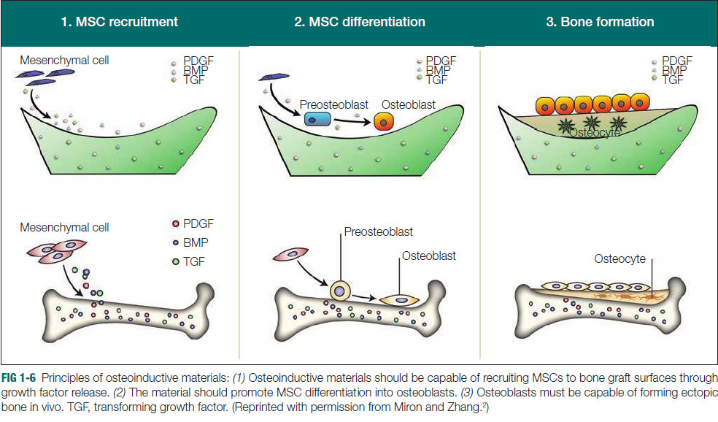

Slide 13
Freeze-Dried Bone Allograft
Undemineralized FDBA was introduced to periodontal therapy in 1976 (Mellonig et al., 1976).
Freeze drying removes approximately 95% of the water from bone by a process of sublimation in a vacuum.
Although freeze drying kills all cells, the morphology, solubility, and chemical integrity of the original specimen are maintained relatively intact (Friedlaender, 1988; Mellonig,1980 and 1991).
Freeze drying also markedly reduces the antigenicity of a periodontal bone allograft

Slide 14
Processing of FDBA
STEP 3. INITIAL CLEANSING AND DECONTAMINATION
STEP 2. INITIAL SIZE REDUCTION
STEP 1. SOFT TISSUE STRIPPING
STEP 4. MICROBIOLOGICAL TREATMENT
STEP 5. FREEZING

Slide 15
STEP 8. PACKAGING
STEP 7. SECONDARY SIZE REDUCTION
STEP 6. DEHYDRATION
STEP 9. TERMINAL STERILIZATION
(Holtzclaw et al. 2008) (Copyright c 2008 American Dental Association.)

Slide 16
It was used in the treatment of:
three-wall intrabony defects adjacent to implants in dogs (Choi et al. 2010),
maxillary sinus-augmentation procedures (Kolerman et al. 2008),
in alveolar ridge augmentation alone (Fagan et al. 2008) or associated with PRP (Kassolis et al. 2000),
periodontal defects, alone (Nevins et al. 2007; Laurell et al. 1998), combined with EMD (Rosen and Reynolds 2002) or with barrier membrane (Rosen and Reynolds 2001).
FDBA can be combined with antimicrobial therapy, and has been used with tetracycline to regenerate experimental defects in baboons (Drury and Yukna 1991) or during treatment of localized juvenile periodontitis (Evans et al. 1989; Mabry et al. 1985).

Slide 17
Osteoconductive, containment, space maintenance (Reynolds 2003)
Mellonig et al., 1992 - 50% bone fill in 67% defects, Bowers et al., 1976 - 78% of defects
Resorbed and replaced by bone (Rosenberg and Rose 1998)
No report of virus contamination
No periodontal regeneration (Anton Sculean 2010)
Useful in minor ridge augmentation

Slide 18
Demineralized Freeze-Dried Bone Allograft
Marshall Urist 1965 Demineralization of a bone allograft exposes bone morphogenetic proteins within the bone matrix.
Bowers et al.,1989 - New attachment histologically
Osteoinductive & Osteoconductive
These inductive proteins induce a cascade of events leading to cellular differentiation and the formation of bone through osteoinduction by inducing pleuripotential stem cells to differentiate into osteoblasts (Mellonig et al. 1992; Nasr et al. 1999).

Slide 19
Processing of DFDBA
STEP 3. INITIAL CLEANSING AND DECONTAMINATION
STEP 2. INITIAL SIZE REDUCTION
STEP 1. SOFT TISSUE STRIPPING
STEP 4. MICROBIOLOGICAL TREATMENT
STEP 5. FREEZING

Slide 20
STEP 8. DEMINERALIZATION
STEP 7. SECONDARY SIZE REDUCTION
STEP 6. DEHYDRATION
STEP 9. BUFFERING
STEP 10. FINAL RINSE

Slide 21
STEP 11. PACKAGING
STEP 12. TERMINAL STERILIZATION
(Holtzclaw et al. 2008) (Copyright c 2008 American Dental Association.)

Slide 22
The AATB advocates excluding collection of bone under the following circumstances:
Donors from high-risk groups, as determined by medical testing and/or behavioral risk assessments.
2. Donors test positive for HIV antibody by ELISA.
3. Autopsy of donor reveals occult disease.
4. Donor bone tests positive for bacterial contamination.
5. Donor and bone test positive for hepatitis B (HBsAG) or C virus
6. Donor tests positive for syphilis.

Slide 23
When DFDBA is used in particulate form, particle size appears to be an important variable in the success of DFDBA as a bone-inductive material.
Particles in the range of 125–1,000 mm possess a higher osteogenic potential than do particles below 125 mm.
Optimal particle size appears to be between 100 and 300 mm.
Very small DFDBA particles elicit a macrophage response and are rapidly resorbed with little or no new bone formation.
Tissue banks most frequently produce this graft with the range
from 250 to 750 mm for dental use (Committee on Research, Science and Therapy of the American Academy of Periodontology 2001).

Slide 24
Schwartz et al. (1996) : commercial DFDBA differs in both size and ability to induce new bone formation, but that the two are not related.
Some investigators have reported success while others have failed to demonstrate clinical improvement (Becker 1994, 1998)
In addition variability also has been reported in the ability of DFDBA to induce new bone formation in animal studies (Pinholt, 1992, Becker, 1992)

Slide 25
Contradictory conclusions
Meta-analysis by Trombelli et al. (2002): The results showed a limited, not statistically significant, greater CAL gain for grafted group with respect to OFD.
Meta-analysis performed by Reynolds et al. (2003) on 12 studies, showed a greater clinical attachment level gain for the grafted group with respect to OFD.

Slide 26
  Insufficient quantity of bone induction proteins
  Bone induction proteins present but in an inactive form.
  Particle size
  Influenced by age of donor but not gender
  Degree of demineralization - 2% residual calcium - nucleation site for re deposition of calcium phosphate (Zhang 1997, J Periodontol)
  Tissue banks do not use identical methods of DFDBA preparation
Sterilization of the graft
  ETO – can decrease effectiveness &resorption of allograft
  Gamma irradiation – reduces bone induction ability by 40%

Slide 27
Libin et al (1975), were the first to report the use of cortical and Cancellous DFDBA in humans .
Cortical bone (DFDBA) - 2.4mm bone fill ( 27 IOD)
Cancellous (DFDBA) - 1.38mm bone fill
Controlled site - 0.66mm bone fill.
According to Bowers (1989), DFDBA remains the only bone replacement graft proven to result in periodontal regeneration in a controlled human histological study .

Slide 28
Rejection
1984 - One case report
Infection
1988 - One case of HIV
1996 - Four cases
Risk – 1 in 1 to 8 million – HIV (Buck et al., 1990)
Risk - 1 in 2.8 billion (TB)

Slide 29
FDBA vs DFDBA
Rummelhart et al.,
1989
22 defects treated with DFDBA vs FDBA
Osseous fill: 1.7 mm (59%) - DFDBA and 2.4 mm (66%) - FDBA
AAP Position Paper
2005
Bone fill with FDBA ranged from 1.6 to 2.3mm
CAL gain 1.7mm DFDBA and 2.0 mm FDBA
Bone fill with DFDBA ranged from 1.7 to 2.9mm
Similar in both DFDBA and FDBA
No significant difference
No significant difference
6 months post op evaluation

Slide 30
CONCLUSION
For the past three decades, allografts have been used alone or in combination with other regenerative modalities in implant dentistry and periodontal therapy.
Becker et al were one of the first to show the bone-inducing ability of DFDBA in comparison to other bone grafting alternatives.
Although not as potent for bone regeneration as autogenous bone, it is now widely accepted that allografts support regeneration of periodontal and osseous tissues due to their excellent combination of osteoconduction and osteoinduction.
The presence of growth factors contained within certain allografts allows for mesenchymal cell migration and supports their future differentiation to bone-forming osteoblasts.

